Slide 1
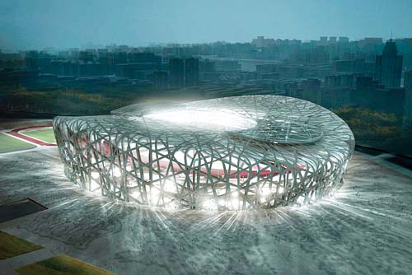
Software Architecture
Dr Roopak Sinha and Dr Quan Bai

Slide 2
What did we do last week?
Got introduced
Assignment description and important dates
Surveys
Software development and some challenges

Slide 3
Related Course Outcome(s)
Explain the factors and issues that come into play in the development of large-scale software systems.

Slide 4
Outline
What is architecture?
Why do we need architecture?
Where do architectures come from?
Architecture activities

Slide 5
What do you already know?
What is software architecture?
Based on your “stake” in a software project, how do you “view” its architecture?
What is design?
Why do we need an architecture?

Slide 6
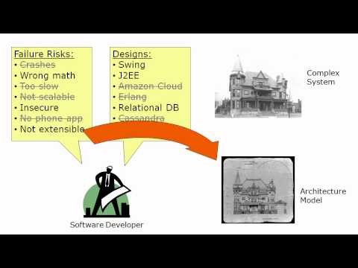
Let’s start with a Video

Slide 7
Programmer, Software Engineer and Software Architect
Job titles on seek.co.nz, searched on 13/July/2015
Software architect: 96
Software engineer: 245
Programmer: 366
Software
architects
$80,000-$150,000
Software
engineers
$70,000-120,000
Programmers
$45,000-100,000

Slide 8
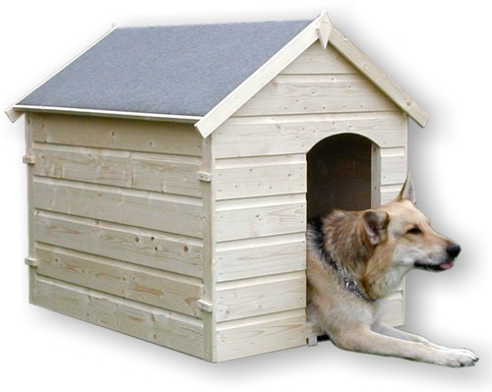

Why do we need architecture?
Do you need architecture when you build something simple?
How about something big and complex?
a global understanding of a complicated system
analysis of design alternatives,
and of general system properties
before such system is built
or without having access to it
Can be built by one person
Requires
Minimal modeling
Simple process
Simple tools
No, because:
Hermannsdenkmal
1838-1875, statue of Arminius (Hermann) who defeated the Romans in A.D. 9 in the Teutoburger
Wald

Slide 9
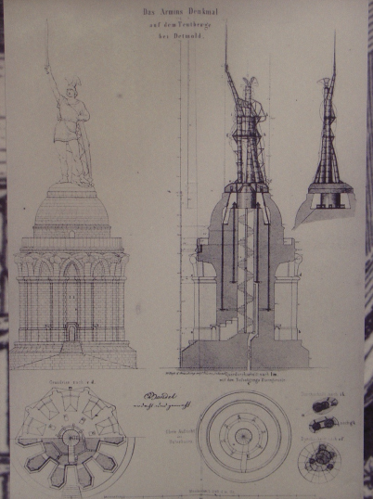
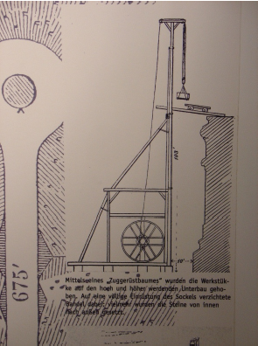
Communication with builders
Compute structure strength, relate to boundary conditions (e.g. wind)
Design, ‘Decomposition’
Structure
Methods for putting together the parts

Slide 10
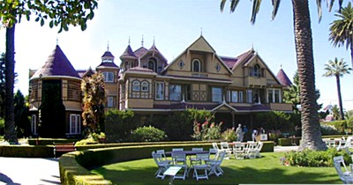

The Need of Architecture The Winchester “Mystery” House
38 years of construction – 147 builders 0 architects
160 rooms – 40 bedrooms, 6 kitchens, 2 basements, 950 doors
65 doors to blank walls, 13 staircases abandoned, 24 skylights in floors
No architectural blueprint exists

Slide 11
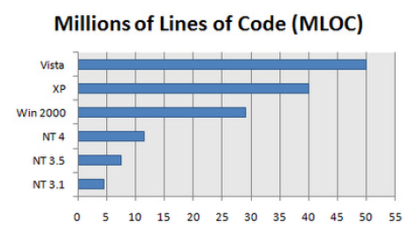
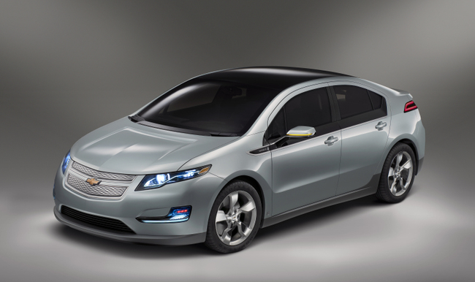
Why do we need software architecture?
Exam question
A software system can be big and complex?
The complexity can be from:
The size of the system
The Windows:
What else Got 10M Lines of Code?
The GM Volt: http://gigaom.com/2010/11/01/whats-got-10m-lines-of-code-an-ip-address-the-volt/

Slide 12


Why do we need software architecture?
If you are writing a program for yourself, you will be the ONLY developer and maybe no one else will use it
If you are developing a complex system:
you need to work with many different people
The system may be developed in different iterations
Design and planning are essential

Slide 13
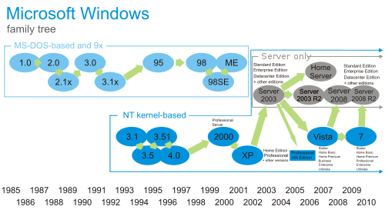
The constraints of the project
Time
Budget
Techniques
Etc.
The changes
Requirement change
Environment change

Slide 14
Exam question
Activities in developing complex software systems:
Understanding, documentation:
structure and meaning of a system can be understood without all details
a person completely new to a system must be able to learn how it works after it has been created.
feedback to users and customers must be given timely in order to see whether the right product is made
a single person has only a partial understanding of a large system
Analysis
need to examine design alternatives without detailed reference to implementation
system properties (e.g. performance) must be inferred at a high abstraction level
it must be possible to answer questions about a system
Communication
larger software and systems are made in teams;
people in the teams must communicate
teams work at different levels of detail
Construction
the development process cannot be ‘single shot’
development evolves in stages, incremental design with different teams
systems are put together from existing, independent components

Slide 15
What is software architecture about?
Exam question
Software architecture helps handle and manage the complexities in software development
Software architect refers to a broad range of roles.
Duties:
Design
Communication: architects also have to communicate effectively, not only to understand the business needs, but also to advance their own architectural vision.”

Slide 16
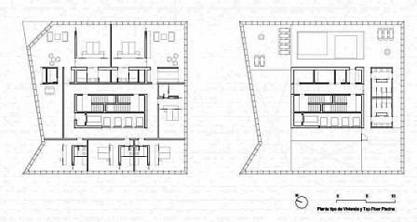
What is architecture about?
Architecture:
What elements will be included?
Functions of those elements
Relationships among those elements
Software architecture of a computing system is the structure or structures of the system, which comprise software elements, the externally visible properties of those elements, and the relationships among them
Architecture is used for understanding, analysis, communication, construction, documentation, etc.

Slide 17
Where do architectures come from?
Vasa: the Swedish Ship
Software architecture is a set of decisions, and is a result of technical, business, and social influences.

Slide 18






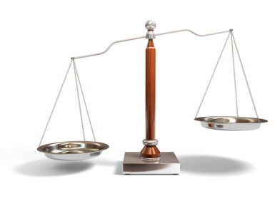
Architectures are influenced by stakeholders:
Management stakeholder
Marketing stakeholder
Maintenance stakeholder
End users
Customer stakeholder
Low cost
Neat features
Easy to maintain
Security
Usability
Not changed often
Architect

Slide 19
Exam question
Architectures are influenced by the developing organisation:
Resources
Strategic goals of the organisation
Organisation structure
Architectures are influenced by the architect:
Knowledge background
Experience
Architectures are influenced by the technical environment:
Fancy techniques (or words)
“Fashions”

Slide 20

Bidirectional influence:
Architect’s experience
Stakeholders
Architecture
Developing organisation
Architect
System
Technical environment

Slide 21
Architecture activities
Business analysis (for commercial products)
Your market
Targeted time to market
Requirement analysis
Functional & non-functional requirements
Different techniques: user scenarios, formal methods
Creating or selecting the architecture
Communicating the architecture
Documenting
Analysis and evaluation
Software implementation (based on the architecture)
Maintenance, revision

Slide 22
Models, viewpoints and views
Exam question
Model:
Abstraction of a system
leaving out details irrelevant to a given set of criteria (“concerns”)
while preserving the properties of interest with respect to those concerns
Viewpoint:
a way of looking at a system from the perspective of a certain stakeholder with a particular concern
the viewpoint defines creation, depiction and analysis of a view
language, used models, notation, methods, analysis techniques, ...
the viewpoint defines the mentioned concerns (criteria of abstraction) to build a view from models
stakeholders: represent different areas of expertise / interest in the system and can have many concerns
View:
a collection of models described in formal or informal ways (e.g., graph, text, math, …)
the view yields the means to address the concerns in the viewpoint, typically, via particular models
the view conforms to the viewpoint, i.e. it is described according to the conventions of the viewpoint and represents what you ‘see’ from that viewpoint

Slide 23

















Viewpoints and views
Australia?
A Hollywood view
A zoology view
Australia is a “complex system”, and we have so many ways to describe her
A sport view

Slide 24
Modern software systems are more than complex enough to make it difficult to grasp them all at once.
An architectural view is a representation of a coherent set of architectural elements as written by and read by system stakeholders. It consists of:
A representation of a set of elements
The relations among the elements

Slide 25

Models, viewpoints and views
Exam question
Stakeholder
viewpoint
View 1
Model 1
System
Stakeholder
viewpoint
View 1
Model 2
Stakeholder
View 1
Model 3
viewpoint
Model 4

Slide 26
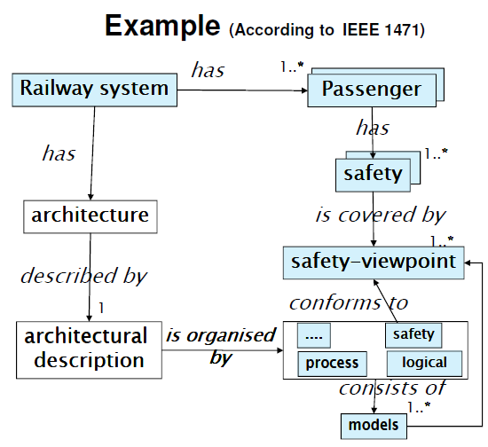

Slide 27
Exercise
In groups of 3-4, discuss who the stakeholders are, their viewpoints, and views for your chosen project topic
Or just choose any software project and role play

Slide 28
Incompleteness
Architecture is described in a set of views
The views do not cover all aspects
e.g. architecture design decisions may not be relevant in the logical view
hence, the architecture contains models that do not clearly address a stakeholder concern
An architectural description is always incomplete
it specifies a class of solutions
we want to leave freedom, e.g. for allowing implementation choices
it simply does not describe all system details. Hence, relative completeness to a set of concerns

Slide 29
In architecture design, we should always consider:
Who are we presenting to?
Which view(s) is/are suitable?
What is the importance of each ‘ility’?
E.g., nobody wants a system that is not maintainable, but perhaps you do not want to double the price for that reason, but a tradeoff might be possible?
In this level/view, what are the building blocks, connectors, rules, constraints?
Are they consistent within and among views?
Is the architecture complete?
Can I realize (refine) the architecture towards an implementation? Namely, is my design implementable?

Slide 30
Readings:
Aleti, Aldeida, et al. "Software architecture optimization methods: A systematic literature review." Software Engineering, IEEE Transactions on 39.5 (2013): 658-683.
Atzori, Luigi, Antonio Iera, and Giacomo Morabito. "The internet of things: A survey." Computer networks 54.15 (2010): 2787-2805.
Rajkumar, Ragunathan Raj, et al. "Cyber-physical systems: the next computing revolution." Proceedings of the 47th Design Automation Conference. ACM, 2010.
(These are available from Google Scholar/AUT library databases)

Slide 31
Homework
For your chosen project topic/area
Consider the need for software architecture
What factors make this architecture different/unique?
What viewpoints would you need to consider?
What useful information would models in each view capture?

Slide 32
Questions?

